Slide 1


Integrating Health Data for Sustainable Development
Data Integration Project
Results
Huthayfa Mutan

Slide 2
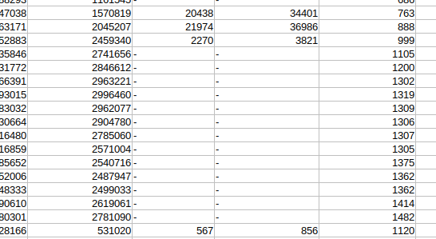
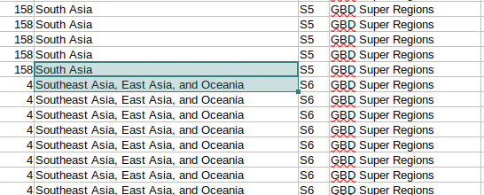
Experiments. Cleaning:
Multiple Vague locations such as unions, continents, summed up results for the globe. Vague Indicator Names such as ppp which was solved manually. Missing data. Mismatching names because of different spelling.

Slide 3
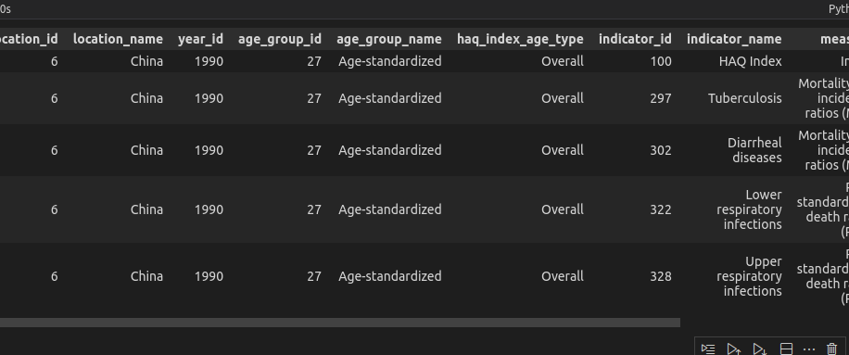
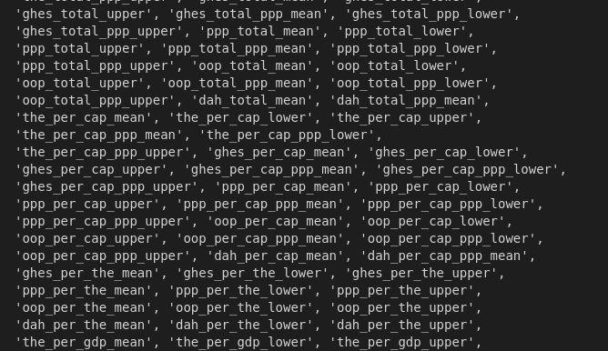
Before:

Slide 4
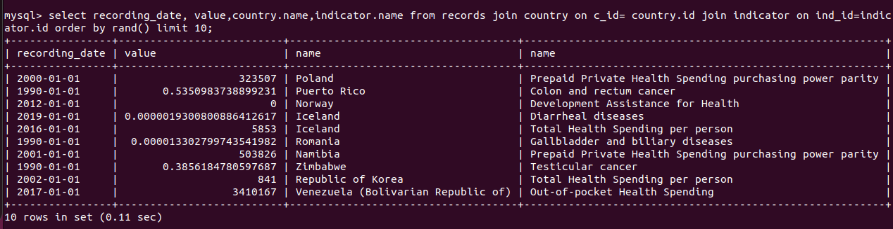
After:

Slide 5
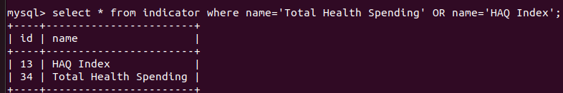
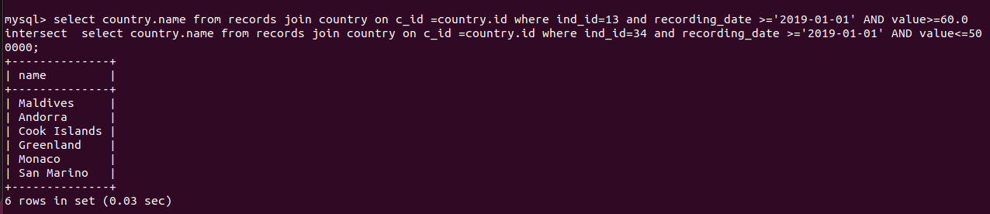
Results (Show cases).
What countries have Total Health Spending Lower than 500 millions and HAQ Index HIGHER than 60.

Slide 6
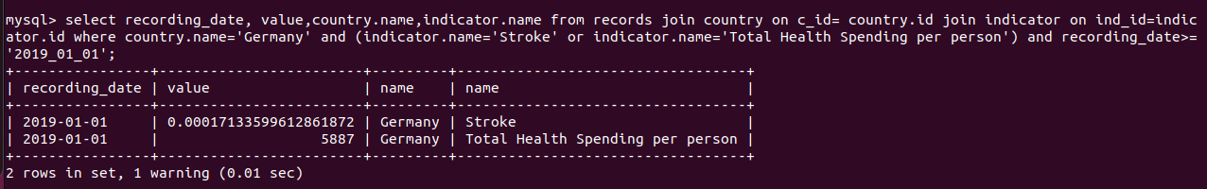
Results (Show cases).
What is the Development Assistance for Health per person compared with Stroke Risk-standardised death rates (RSD) for germany for the year 2019.

